Slide 1
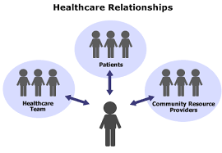
WEARABLE TECHNOLOGY IN HEALTHCARE SYSTEM USING EXPLAINABLE AI

Slide 2
Lime( local interpret model-agostic explain)

Slide 3
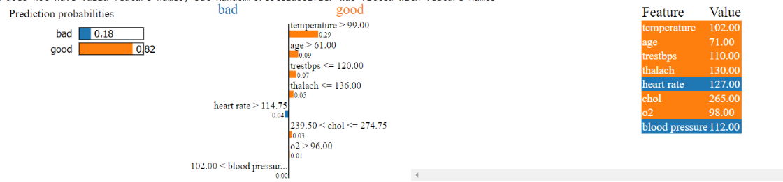
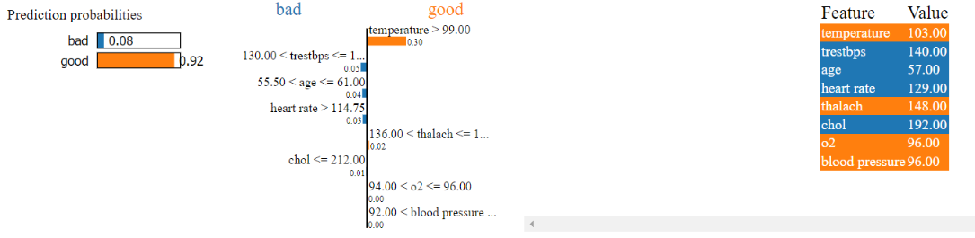
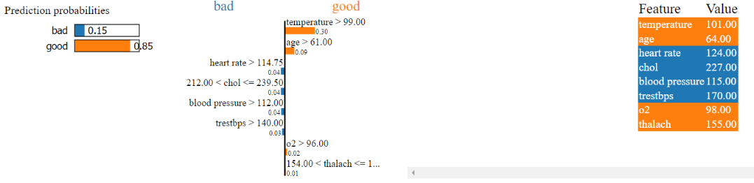
Plot for iloc(4)
Plot for iloc(10)
Plot for iloc(20)

Slide 4
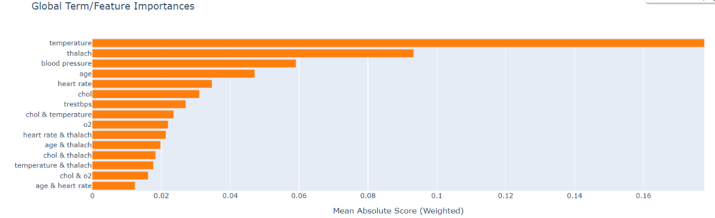
Global interpret

Slide 5
Interpret the parameters individually(component graph)

Slide 6
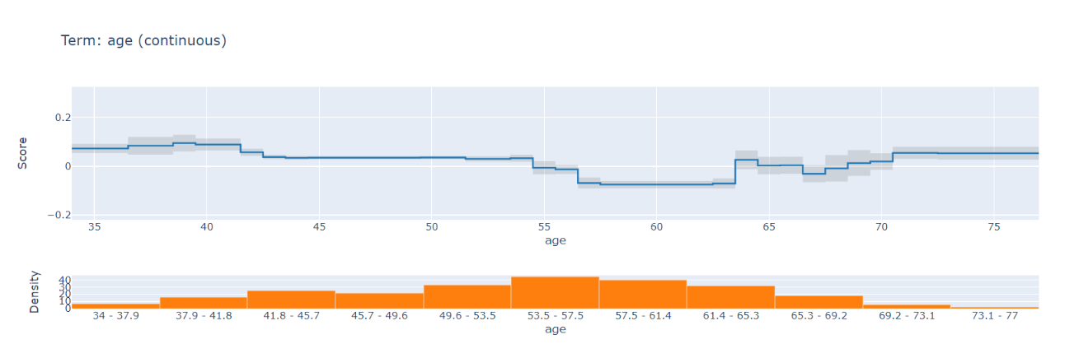
Interpret on age parameter

Slide 7
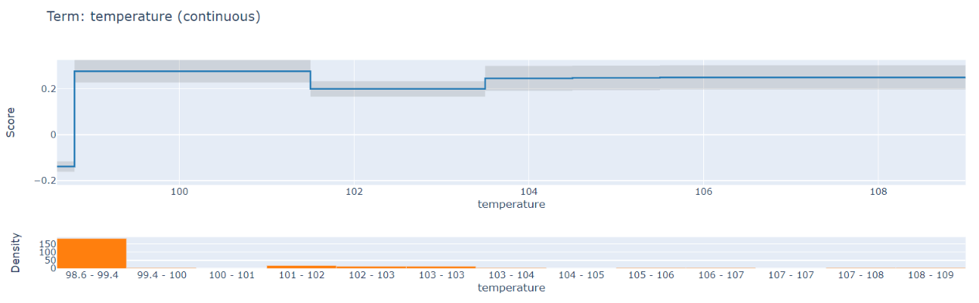
Interpret on temperature parameter

Slide 8
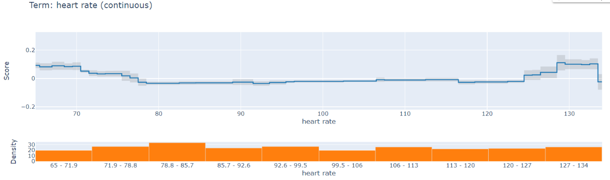
Interpret on heart rate parameter

Slide 9
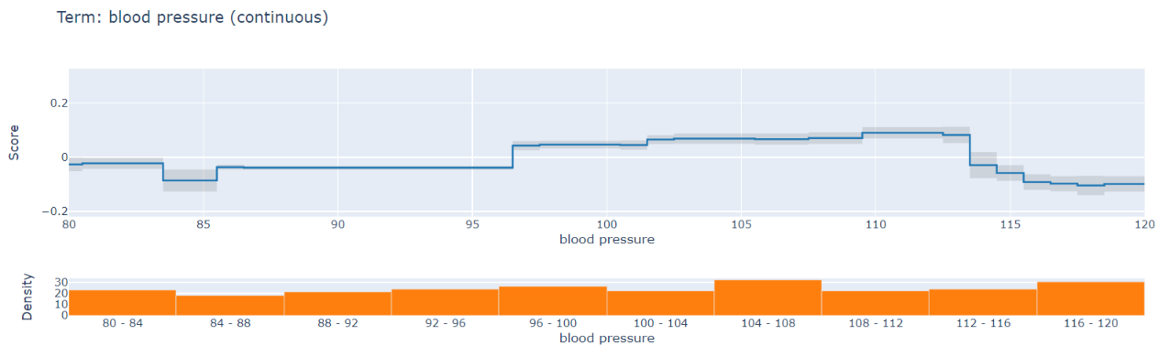
Interpret on blood pressure parameter

Slide 10
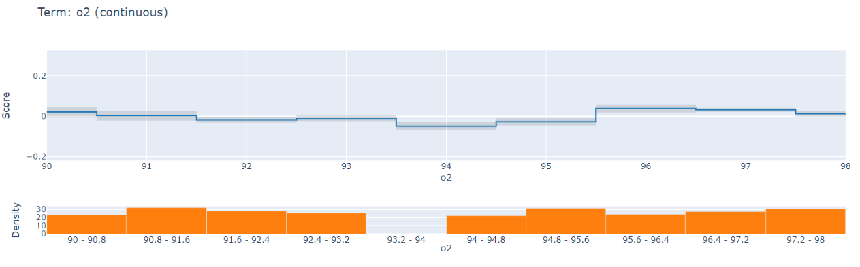
Interpret on o2 level

Slide 11
Shap(SHapley Additive exPlanations)

Slide 12
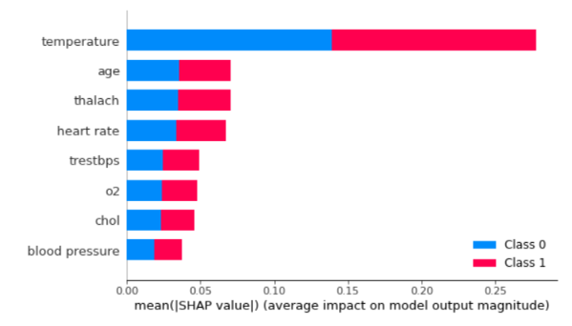
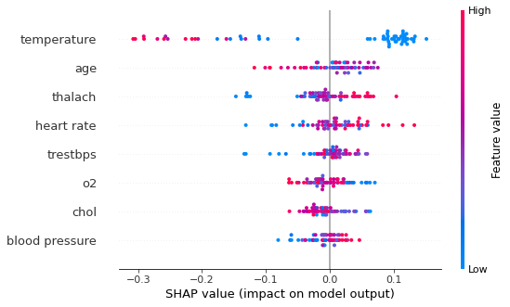
Shap (*)how much amount does the parameter impact on ml model

Slide 13
Ebm(explainable boosting machine)

Slide 14
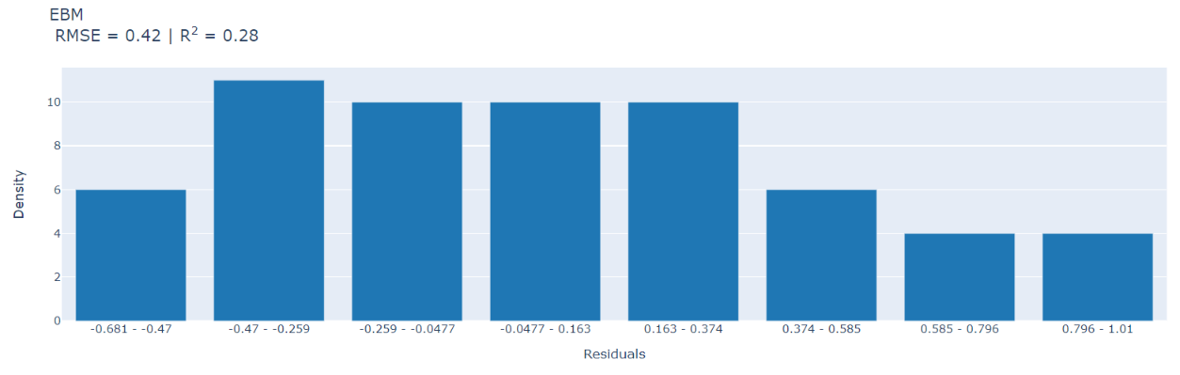
Root mean square plot for explainable boosting machine

Slide 15
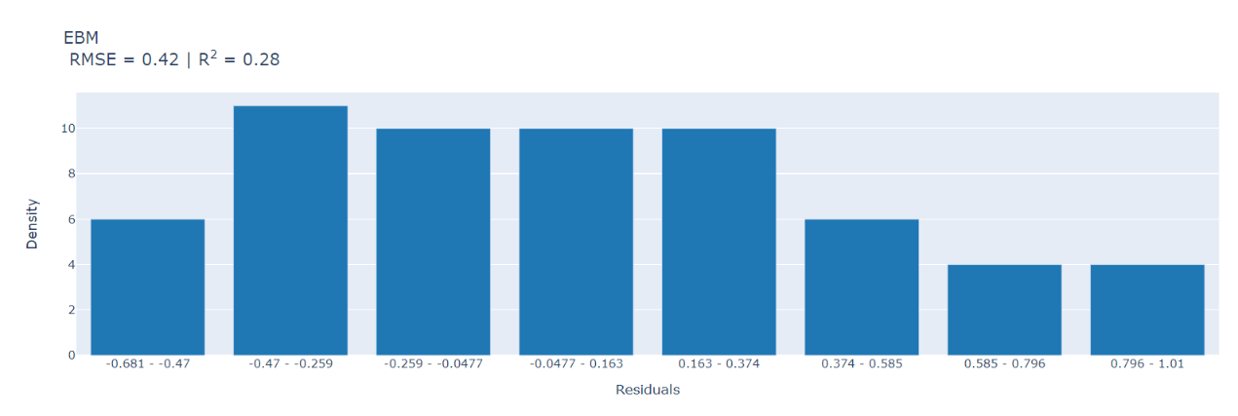
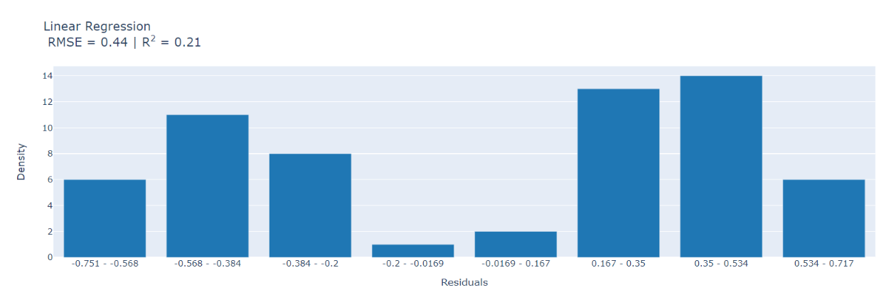
Component graph for ebm

Slide 16
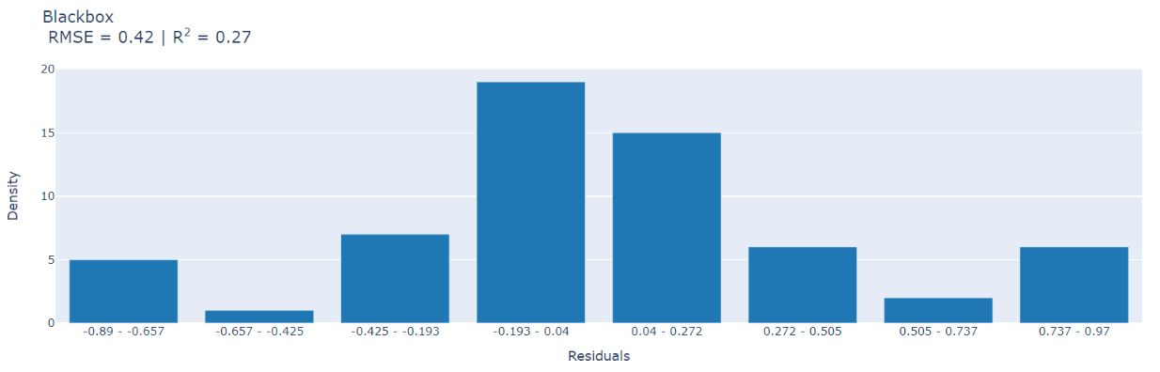
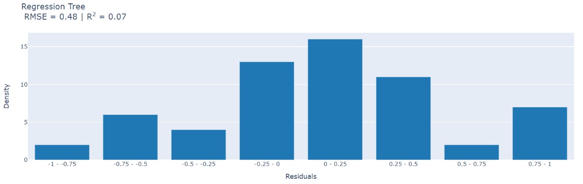

Slide 17
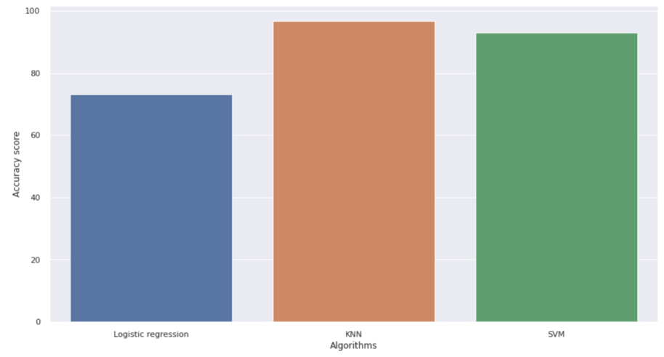
Accuracy plot for algorithm

Slide 18

runtime

Slide 19
end

